Slide 1
Case Study on Airlines Analysis (Sprint 2)
Batch: BI V7 with MS Azure PT Sep 6th Batch1
Group Members:
Harshit Mudgal
Abhaya Shankar
Armaandeep Sandhu
Ashitosh Joshi
Abhishek Baghel
Presentation Date: 10th November 2022

Slide 2
Problem Statement
To create an end to end flow for executing the queries related to Airlines Analysis using Jupyter Notebook and generating visualizations.
Tasks to be performed:
Load the dataset in SQL DB
Clean the dataset
Load that data into the Jupyter Notebook
Execute the queries as per the case study document.
Get possible visualization of data

Slide 3
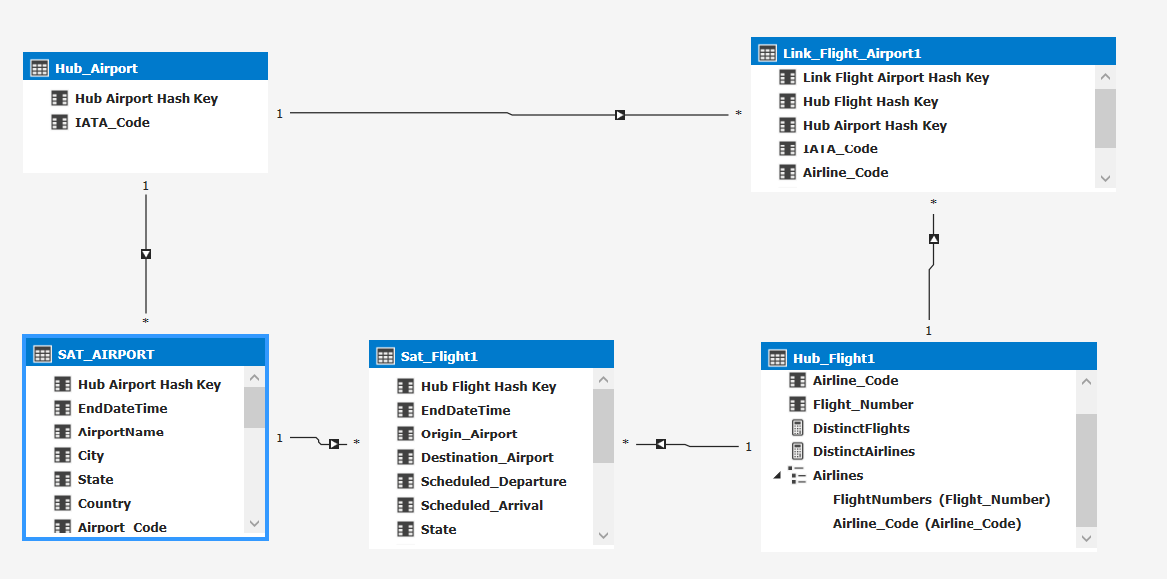
Diagram View of the Dataset

Slide 4
Prerequisites
SQL Server 2017 (or higher) to load database
Miniconda with Jupyter Notebook
Pyodbc module to create connection with database
Pandas, matplotlib and seaborn libraries to generate visualizations

Slide 5
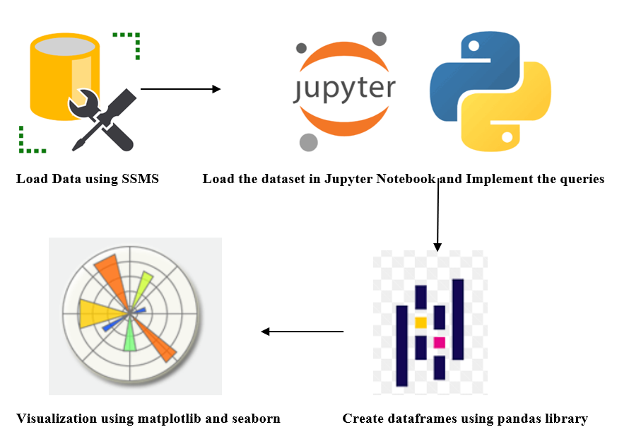
Project Design

Slide 6
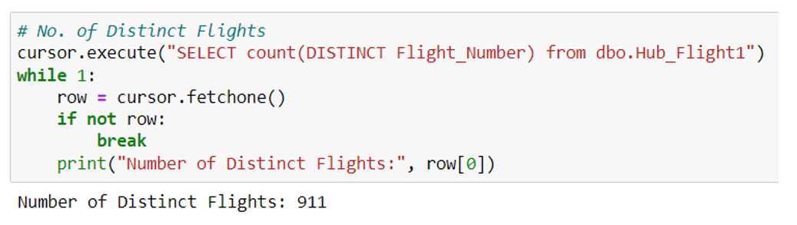
Sample Query - 1
No. of different flights running

Slide 7
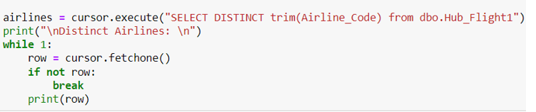
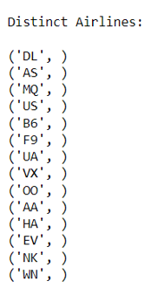
Sample Query - 2
Different Airlines Available

Slide 8
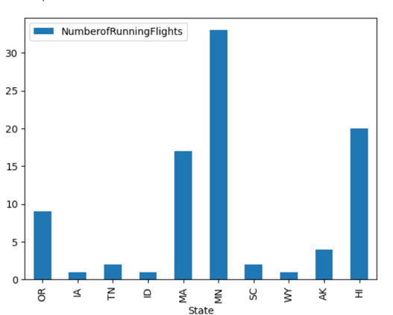
Sample Visualization-1
State Wise Number of Flights (Top 10)

Slide 9
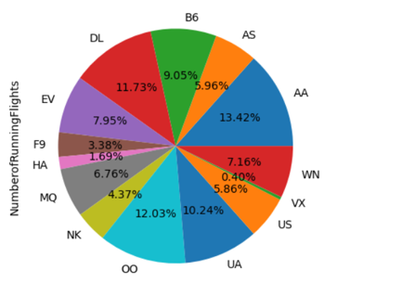
Sample Visualization-2
Airline Wise Number of Flights

